Slide 1
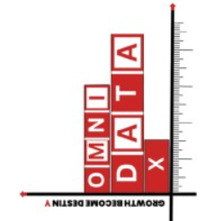
Play Store Review Analytics (redBus)
OmniDataX | June,30 Lokesh Kona
Insights and Metrics for Client Demo

Slide 2

Project Goal
To analyze redBus app reviews to uncover key insights on customer satisfaction, common complaints, and feature expectations
Reviews Collected: 1200+
Fields: Reviewer Name, Rating, Review,
Date, Usefulness, Reply, Reply Date
Average Original Rating: 4.3
Average Sentiment Score Rating: ~3.7
Sentiment Labels: Positive, Negative, Neutral

Slide 3
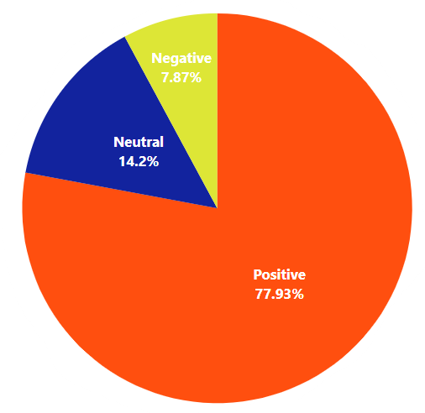
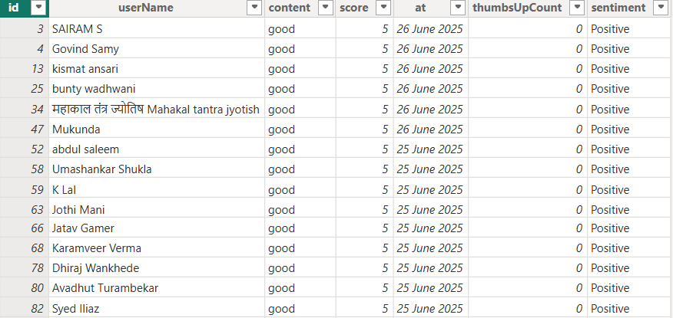
Customer Sentiment Distribution
Sentiment analysis performed using VADER (NLTK) to understand emotional tone of reviews.

Slide 4
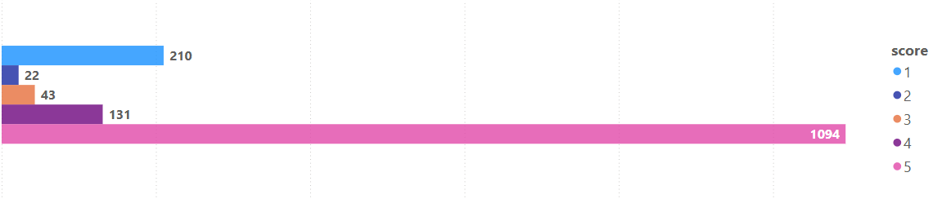
Category | Count | Key Words
UI/UX | 320 | App design,login,menu
Performance | 95 | Crashes,lag,freeze
Refund/Support | 140 | Refund,delay,no response
Feature Requests | 210 | Tracking,wallet,night mode
Top Issues in User Feedback
User Ratings Distribution

Slide 5
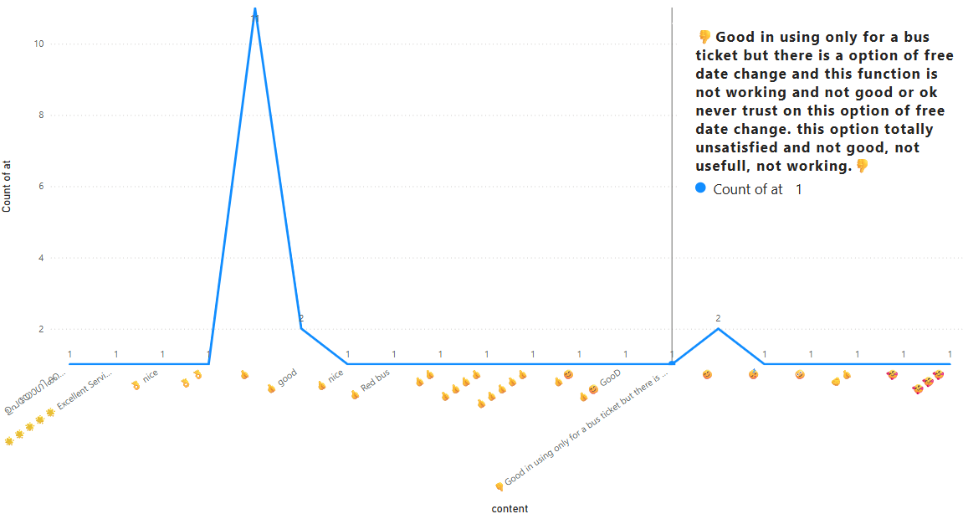
Review Trends Over Time
Spikes in complaints during holiday seasons suggest stress under peak load.

Slide 6
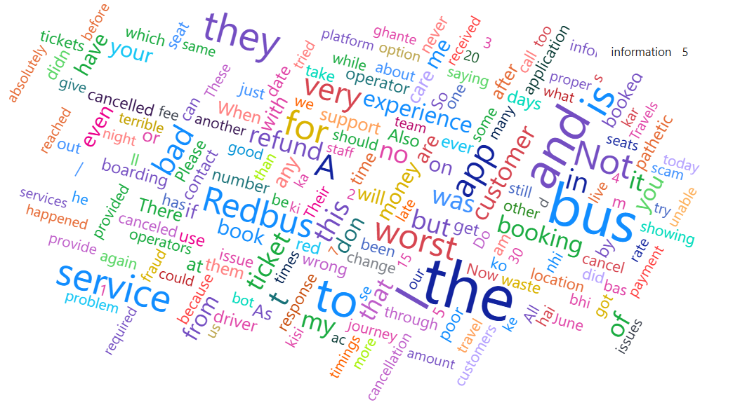
Here is what Key Highlights,Customer Feelings about the app performance

Slide 7
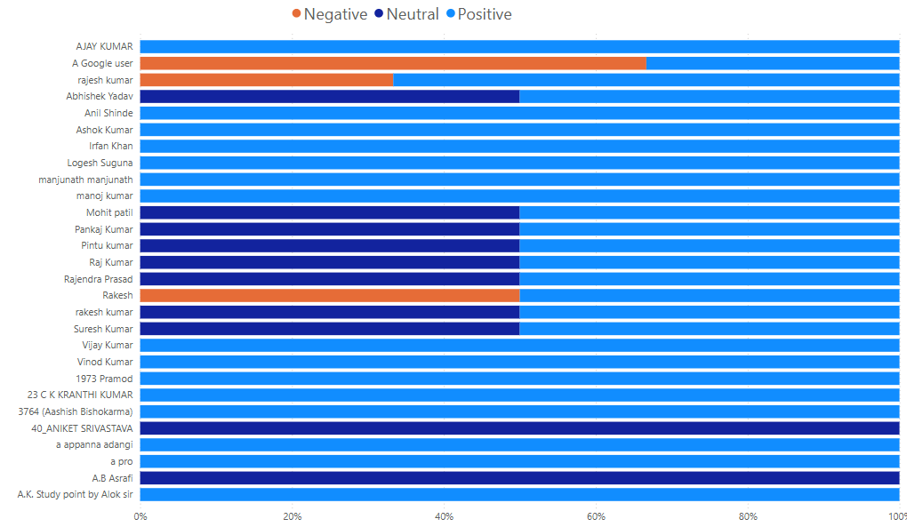
Sentiment Analysis by Stars
Positive Neutral Negative
78% 15% 8%

Slide 8
What Customers are Expecting: Feature Requests & Suggestions!
User Expectations
140 reviewers mentioned poor responce
Real Time Bus Tracking
Faster Wallet refund
Dark Mode Feature
In-app Calender For Booking
Average Support Sentiment:Negative
Direct Impact on Brand trust

Slide 9
We appreciate your time and insights!
Thank You!
Let’s Build A better Experience Together

